Slide 1





Database Transactions
Transaction Management and Concurrency Control
Svetlin Nakov
Manager Technical Training
http://www.nakov.com
Telerik Software Academy
http://academy.telerik.com

Slide 2


Table of Contents
What is a Transaction?
ACID Transactions
Managing Transactions in SQL
Concurrency Problems in DBMS
Concurrency Control Techniques
Locking Strategies: Optimistic vs. Pessimistic Locking
Transaction Isolation Levels
Transaction Log and Recovery
When and How to Use Transactions?
2

Slide 3
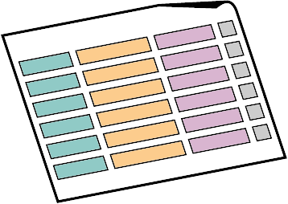


What is a Transaction?

Slide 4
Transactions
Transactions is a sequence of actions (database operations) executed as a whole:
Either all of them complete successfully
Or none of the them
Example of transaction:
A bank transfer from one account into another (withdrawal + deposit)
If either the withdrawal or the deposit fails the whole operation is cancelled
4

Slide 5
A Transaction
Read
Write
Durable starting state
Write
Sequence of reads and writes
Commit
Durable,
consistent,
ending state
Rollback
5

Slide 6
Transactions Behavior
Transactions guarantee the consistency and the integrity of the database
All changes in a transaction are temporary
Changes are persisted when COMMIT is executed
At any time all changes can be canceled by ROLLBACK
All of the operations are executed as a whole
Either all of them or none of them
6

Slide 7
Transactions: Example
Withdraw $100
Transfer $100
Read current balance
New balance = current - $100
Write new balance
Dispense cash
Read savings
New savings = current - $100
Read checking
New checking = current + $100
Write savings
Write checking
7

Slide 8
What Can Go Wrong?
Some actions fail to complete
For example, the application software or database server crashes
Interference from another transaction
What will happen if several transfers run for the same account in the same time?
Some data lost after actions complete
Database crashes after withdraw is complete and all other actions are lost
8
Notes:
Use transfer example, not cash machine for failing to complete

Slide 9
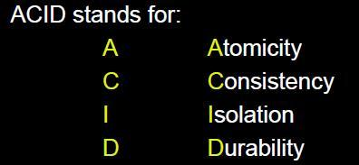


ACID Transactions

Slide 10


Transactions Properties
Modern DBMS servers have built-in transaction support
Implement “ACID” transactions
E.g. MS SQL Server, Oracle, MySQL, …
ACID means:
Atomicity
Consistency
Isolation
Durability
10

Slide 11

Atomicity
Atomicity means that
Transactions execute as a whole
DBMS to guarantee that either all of the operations are performed or none of them
Atomicity example:
Transfer funds between bank accounts
Either withdraw + deposit both execute successfully or none of them
In case of failure the DB stays unchanged
11

Slide 12

Consistency
Consistency means that
The database is in a legal state when the transaction begins and when it ends
Only valid data will be written in the DB
Transaction cannot break the rules of the database, e.g. integrity constraints
Primary keys, foreign keys, alternate keys
Consistency example:
Transaction cannot end with a duplicate primary key in a table
12

Slide 13

Isolation
Isolation means that
Multiple transactions running at the same time do not impact each other’s execution
Transactions don’t see other transaction’s uncommitted changes
Isolation level defines how deep transactions isolate from one another
Isolation example:
Manager can see the transferred funds on one account or the other, but never on both
13

Slide 14

Durability
Durability means that
If a transaction is committed it becomes persistent
Cannot be lost or undone
Ensured by use of database transaction logs
Durability example:
After funds are transferred and committed the power supply at the DB server is lost
Transaction stays persistent (no data is lost)
14

Slide 15
ACID Transactions and RDBMS
Modern RDBMS servers are transactional:
Microsoft SQL Server, Oracle Database, PostgreSQL, FirebirdSQL, …
All of the above servers support ACID transactions
MySQL can also run in ACID mode (InnoDB)
Most cloud databases are transactional as well
Amazon SimpleDB, AppEngine Datastore, Azure Tables, MongoDB, …
15

Slide 16



Managing Transactions in SQL Language

Slide 17
Transactions and SQL
Start a transaction
BEGIN TRANSACTION
Some RDBMS use implicit start, e.g. Oracle
Ending a transaction
COMMIT
Complete a successful transaction and persist all changes made
ROLLBACK
“Undo” changes from an aborted transaction
May be done automatically when failure occurs
17

Slide 18
Transactions in SQL Server: Example
We have a table with bank accounts:
We use a transaction to transfer money from one account into another
CREATE TABLE Accounts(
Id int NOT NULL PRIMARY KEY,
Balance decimal NOT NULL)
CREATE PROCEDURE sp_Transfer_Funds(
@from_account INT,
@to_account INT,
@amount MONEY) AS
BEGIN
BEGIN TRAN;
(example continues)
18

Slide 19
Transactions in SQL Server: Example (2)
UPDATE Accounts SET Balance = Balance - @amount
WHERE Id = @from_account;
IF @@ROWCOUNT <> 1
BEGIN
ROLLBACK;
RAISERROR('Invalid src account!', 16, 1);
RETURN;
END;
UPDATE Accounts SET Balance = Balance + @amount
WHERE Id = @to_account;
IF @@ROWCOUNT <> 1
BEGIN
ROLLBACK;
RAISERROR('Invalid dest account!', 16, 1);
RETURN;
END;
COMMIT;
END;
19

Slide 20

Transfer Funds
Live Demo

Slide 21

Concurrency Problems in Database Systems

Slide 22
Scheduling Transactions
Serial schedule – the ideal case
Transactions execute one after another
No overlapping: users wait one another
Not scalable: doesn’t allow much concurrency
Conflicting operations
Two operations conflict if they:
are performed in different transactions
access the same piece of data
at least one of the transactions does a write operation to that piece of data
22

Slide 23
Serial Schedule – Example
T1: Adds $50 to the balance
T2: Subtracts $25 from the balance
T1 completes before T2 begins
No concurrency problems
Time
Trans.
Step
Value
1
T1
Read balance
100
2
T1
Balance = 100 + 50
3
T1
Write balance
150
4
T2
Read balance
150
5
T2
Balance = 150 - 25
6
T2
Write balance
125
23

Slide 24
Serializable Transactions
Serializability
Want to get the effect of serial schedules, but allow for more concurrency
Serializable schedules
Equivalent to serial schedules
Produce same final result as serial schedule
Locking mechanisms can ensure serializability
Serializability is too expensive
Optimistic locking allows better concurrency
24

Slide 25
Concurrency Problems
Problems from conflicting operations:
Dirty Read
A transaction updates an item, then fails
The item is accessed by another transaction before the rollback
The second transaction reads invalid data
Non-Repeatable Read
A transaction reads the same item twice
And gets different values
Due to concurrent change in another transaction
25

Slide 26
Concurrency Problems (2)
Problems from conflicting operations:
Phantom Read
A transaction executes a query twice
And gets a different number of rows
Due to another transaction inserted new rows in the meantime
Lost Update
Two transactions update the same item
The second update overwrites the first
Last update wins
26

Slide 27
Concurrency Problems (3)
Problems from conflicting operations:
Incorrect Summary
One transaction is calculating an aggregate function on some records
While another transaction is updating them
The result is incorrect
Some records are aggregated before the updates
Some after the updates
27

Slide 28
Dirty Read – Example
Time
Trans.
Step
Value
1
T1
Read balance
100
2
T1
Balance = 100 + 50
3
T1
Write balance
150
4
T2
Read balance
150
Uncommitted
5
T2
Balance = 150 - 25
6
T1
Rollback
Undoes T1
7
T2
Write balance
125
Update from T1 was rolled back, but T2 doesn’t know about it, so finally the balance is incorrect
T2 writes incorrect balance
28

Slide 29
Lost Update – Example
Time
Trans.
Step
Value
1
T1
Read balance
100
2
T2
Read balance
100
3
T1
Balance = Balance + 50
4
T2
Balance = Balance - 25
5
T2
Write balance
150
6
T1
Write balance
75
Update from T1 is lost because T2 reads the balance before T1 was completed
Lost update
29

Slide 30
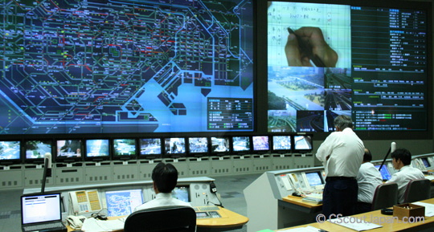
Concurrency Control Techniques

Slide 31
Concurrency Control
The problem
Conflicting operations in simultaneous transactions may produce an incorrect results
What is concurrency control?
Managing the execution of simultaneous operations in the database
Preventing conflicts when two or more users access database simultaneously
Ensuring the results are correct like when all operations are executed sequentially
31

Slide 32
Locking Strategies
Optimistic concurrency control (no locking)
No locks – all operations run in parallel
Conflicts are possible
Can be resolved before commit
High concurrency – scale very well
Pessimistic concurrency control (locking)
Use exclusive and shared locks
Transactions wait for each other
Low concurrency – does not scale well
32

Slide 33


Optimistic Concurrency
Optimistic concurrency control (optimistic locking) means no locking
Based on assumption that conflicts are rare
Transactions proceed without delays to ensure serializability
At commit, checks are made to determine whether a conflict has occurred
Conflicts can be resolved by last wins / first wins strategy
Or conflicted transaction can be restarted
Allows greater concurrency than pessimistic locking
33

Slide 34
Optimistic Concurrency: Phases
Three phases of optimistic concurrency:
Read
Reads DB, perform computations, store the results in memory
Validate
Check for conflicts in the database
In case of conflict → resolve it / discard changes
Write
Changes are made persistent to DB
34

Slide 35
Optimistic Concurrency Example
Read the data from DB:
Remember the state and perform some changes:
Update the original database record:
Check for conflicts happened during the update:
SELECT @fname = FirstName FROM Persons WHERE PersonId = 7
This could take some time (e.g. wait for user action)
@old_fname = @fname
@fname = "Some new name"
UPDATE Persons SET FirstName = @fname
WHERE PersonId = 7 AND FirstName = @old_fname
IF @@ROWCOUNT = 0
RAISERROR ('Conflicting update: row changed. ', 16, 1);
35

Slide 36

Pessimistic Concurrency
Pessimistic concurrency control (pessimistic locking)
Assume conflicts are likely
Lock shared data to avoid conflicts
Transactions wait each other → does not scale well
Use shared and exclusive locks
Transactions must claim a read (shared) or write (exclusive) lock on a data item before read or write
Locks prevents another transaction from modifying item or even reading it, in the case of a write lock
36

Slide 37

Locking – Basic Rules
If transaction has read lock on an item
The item can be read but not modified
If transaction has write lock on an item
The item can be both read and modified
Reads are not conflicting
Multiple transactions can hold read locks simultaneously on the same item
Write lock gives exclusive access to the locked item
Transaction can upgrade a read lock to a write lock
Or downgrade a write lock to a read lock
Commits and rollbacks release the locks
37

Slide 38
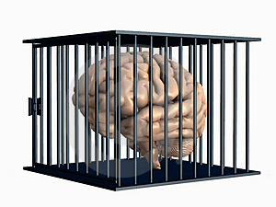
Deadlock
What is deadlock?
When two (or more) transactions are each waiting for locks held by the others
Deadlock example:
A locks the "Authors" table
And tries to modify the "Books" table
B locks the "Books" table
And tries to modify the "Authors" table
Breaking a deadlock
Only one way: abort some of the transactions
38

Slide 39
Dealing with Deadlock
Deadlock prevention
Transaction can’t obtain a new lock if the possibility of a deadlock exists
Deadlock avoidance
Transaction must obtain all the locks it needs upfront (before it starts)
Deadlock detection and recovery
DB checks for possible deadlocks
If deadlock is detected, one of the transactions is killed and an exception is thrown
39

Slide 40



Locking Granularity
What is locking granularity?
The size of data items chosen as unit of protection by concurrency control
Ranging from coarse to fine:
Entire database
Single data file
Data page (block)
Table record
Field value of a record
40

Slide 41
Coarse vs. Fine Granularity
Coarse granularity
Small number of locks protecting large segments of data, e.g. DB, file, page locks
Small overhead, small concurrency
Fine granularity
Large number of locks over small areas of data, e.g. table row of field in a row
More overhead, better concurrency
DBMS servers are “smart” and use both
41

Slide 42
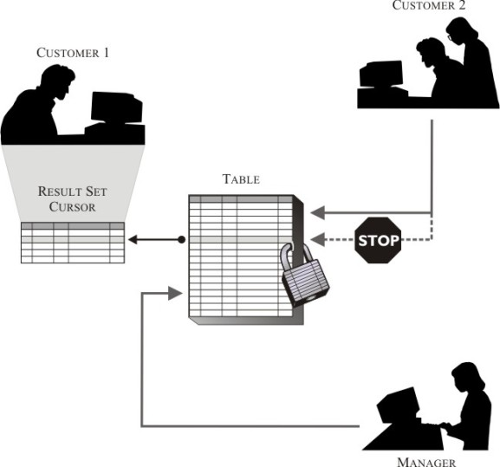
Transaction Isolation Levels

Slide 43
Transactions and Isolation
Transactions can define different isolation levels for themselves
Stronger isolation
Ensures better consistency
Has less concurrency
The data is locked longer
Level of Isolation | Dirty Reads | Repeatable Reads | Phantom Reads
Read uncommitted | yes | yes | yes
Read committed | no | yes | yes
Repeatable read | no | no | yes
Serializable | no | no | no
43

Slide 44
Isolation levels
Uncommitted Read
Reads everything, even data not committed by some other transaction
No data is locked
Not commonly used
Read Committed
Current transaction sees only committed data
Records retrieved by a query are not prevented from modification by some other transaction
Default behavior in most databases
44

Slide 45
Isolation levels
Repeatable Read
Records retrieved cannot be changed from outside
The transaction acquires read locks on all retrieved data, but does not acquire range locks (phantom reads may occur)
Deadlocks can occur
Serializable
Acquires a range lock on the data
Simultaneous transactions are actually executed one after another
45

Slide 46
Snapshot Isolation in SQL Server
By default MS SQL Server applies pessimistic concurrency control
When some transaction updates some data, the other transactions wait it to complete
A special SNAPSHOT isolation level in MS SQL
It enables optimistic concurrency control
When some transaction updates some data, all other transactions see the old data (snapshot)
No locking is applied → no waiting transactions
SET TRANSACTION ISOLATION LEVEL SNAPSHOT
46

Slide 47






Transactions and Isolation in MS SQL Server
Live Demo

Slide 48

Transaction Log and Recovery after Crash

Slide 49
Transaction Log
What is transaction log (REDO log)?
Keep a log of all database writes ON DISK (so that it is still available after crash)
<transaction ID>; <data item>; <new value>
(Tj; x=125) (Ti; y=56)
Actions must be idempotent (undoable / redoable)
But don't write to the database yet
At the end of transaction execution
Add "commit <transaction ID>" to the log
Do all the writes to the database
Add "complete <transaction ID>" to the log
49

Slide 50
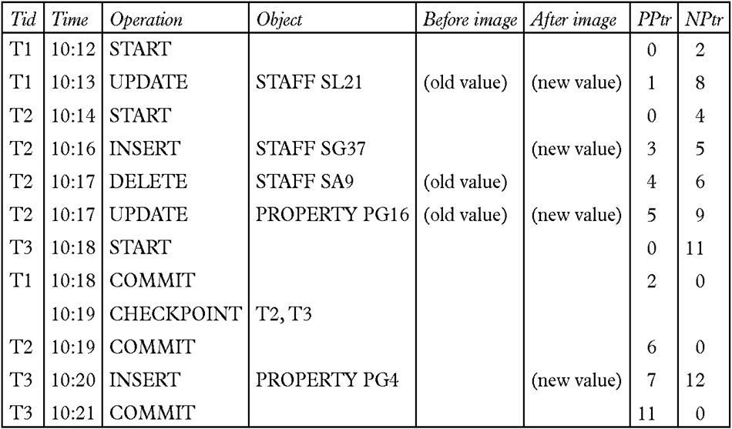
Sample Transaction Log
50
Notes:
September 98
77
Chapter Name

Slide 51
Recovering From a Crash
3 phases in the recovery algorithm:
Analysis
Scan for dirty pages in the transaction log
Redo
Redoes all updates to dirty pages to ensure committed transactions are written to the disk
Undo
All transactions that were active at the crash are undone, working backwards in the log
Also handle the cases during the recovery process
51

Slide 52

When and How to Use Transactions?

Slide 53
Transactions Usage
When to use database transactions?
Always when a business operation modifies more than one table (atomicity)
When you don’t want conflicting updates (isolation)
How to choose the isolation level?
As a rule use read committed, unless you need more strong isolation
Keep transactions small in time!
Never keep transactions opened for long
53

Slide 54
Transactions Usage – Examples
Transfer money from one account to another
Either both withdraw and deposit succeed or neither of them
At the pay desk of a store: we buy a cart of products as a whole
We either buy all of them and pay or we buy nothing and give no money
If any of the operations fails we cancel the transaction (the entire purchase)
54

Slide 55
Database Transactions
http://academy.telerik.com

